Slide 1
Chapter 1: Introduction

Slide 2
Virtualization
Allows operating systems to run applications within other OSes
  Vast and growing industry
Emulation used when source CPU type different from target type (i.e. PowerPC to Intel x86 Rosetta, Intel to M1)
  Generally slowest method
  When computer language not compiled to native code – Interpretation
Virtualization – OS natively compiled for CPU, running guest OSes also natively compiled
  Consider VMware running WinXP guests, each running applications, all on native WinXP host OS
  VMM (virtual machine Manager) provides virtualization services

Slide 3
Virtualization (cont.)
Use cases involve laptops and desktops running multiple OSes for exploration or compatibility
  Apple laptop running Mac OS X host, Windows as a guest
  Developing apps for multiple OSes without having multiple systems
  QA testing applications without having multiple systems
  Executing and managing compute environments within data centers
VMM can run natively, in which case they are also the host
  There is no general purpose host then (VMware ESX and Citrix XenServer)

Slide 4

Computing Environments - Virtualization

Slide 5
Distributed Systems
Distributed computing
  Collection of separate, possibly heterogeneous, systems networked together
    Network is a communications path, TCP/IP most common
      Local Area Network (LAN)
      Wide Area Network (WAN)
      Metropolitan Area Network (MAN)
      Personal Area Network (PAN)
  Network Operating System provides features between systems across network
    Communication scheme allows systems to exchange messages
    Illusion of a single system

Slide 6



Kernel Data Structures
Many similar to standard programming data structures
Singly linked list
Doubly linked list
Circular linked list

Slide 7

Kernel Data Structures
Binary search tree
left <= right
  Search performance is O(n)
  Balanced binary search tree is O(lg n)
  Linux : CPU scheduling algorithm uses

Slide 8

Kernel Data Structures
Hash function can create a hash map
Bitmap – string of n binary digits representing the status of n items
Linux data structures defined in include files <linux/list.h>, <linux/kfifo.h>, <linux/rbtree.h>

Slide 9
Computing Environments - Traditional
Stand-alone general purpose machines
But blurred as most systems interconnect with others (i.e., the Internet)
Portals provide web access to internal systems
Network computers (thin clients) are like Web terminals
Mobile computers interconnect via wireless networks
Networking becoming ubiquitous – even home systems use firewalls to protect home computers from Internet attacks

Slide 10
Computing Environments - Mobile
Handheld smartphones, tablets, etc
What is the functional difference between them and a “traditional” laptop?
Extra feature – more OS features (GPS, gyroscope)
Allows new types of apps like augmented reality
Use IEEE 802.11 wireless, or cellular data networks for connectivity
Leaders are Apple iOS and Google Android

Slide 11

Computing Environments – Client-Server
Client-Server Computing
  Dumb terminals supplanted by smart PCs
  Many systems now servers, responding to requests generated by clients
    Compute-server system provides an interface to client to request services (i.e., database)
    File-server system provides interface for clients to store and retrieve files

Slide 12

Computing Environments - Peer-to-Peer
Another model of distributed system
P2P does not distinguish clients and servers
  Instead all nodes are considered peers
  May each act as client, server or both
  Node must join P2P network
    Registers its service with central lookup service on network, or
    Broadcast request for service and respond to requests for service via discovery protocol
  Examples include Napster and Gnutella, Voice over IP (VoIP) such as Skype

Slide 13
Computing Environments – Cloud Computing
Delivers computing, storage, even apps as a service across a network
Logical extension of virtualization because it uses virtualization as the base for it functionality.
  Amazon EC2 has thousands of servers, millions of virtual machines, petabytes of storage available across the Internet, pay based on usage
Many types
  Public cloud – available via Internet to anyone willing to pay
  Private cloud – run by a company for the company’s own use
  Hybrid cloud – includes both public and private cloud components
  Software as a Service (SaaS) – one or more applications available via the Internet (i.e., word processor)
  Platform as a Service (PaaS) – software stack ready for application use via the Internet (i.e., a database server)
  Infrastructure as a Service (IaaS) – servers or storage available over Internet (i.e., storage available for backup use)

Slide 14

Computing Environments – Cloud Computing
Cloud computing environments composed of traditional OSes, plus VMMs, plus cloud management tools
  Internet connectivity requires security like firewalls
  Load balancers spread traffic across multiple applications

Slide 15
Computing Environments – Real-Time Embedded Systems
Real-time embedded systems most prevalent form of computers
  Vary considerable, special purpose, limited purpose OS, real-time OS
  Use expanding
Many other special computing environments as well
  Some have OSes, some perform tasks without an OS
Real-time OS has well-defined fixed time constraints
  Processing must be done within constraint
  Correct operation only if constraints met

Slide 16
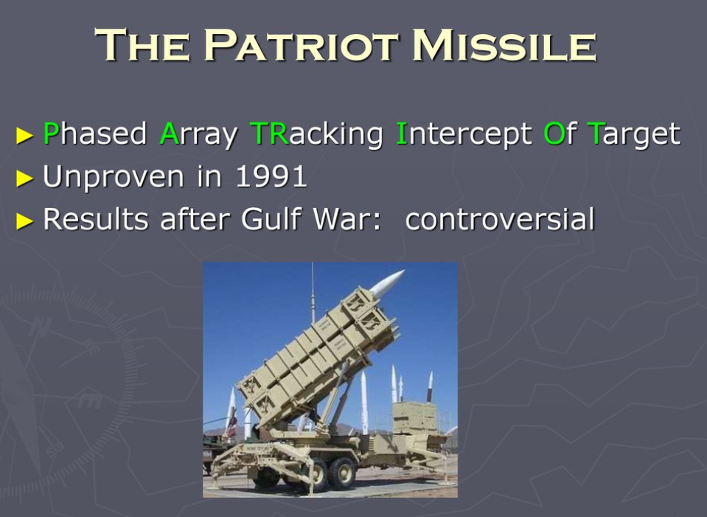
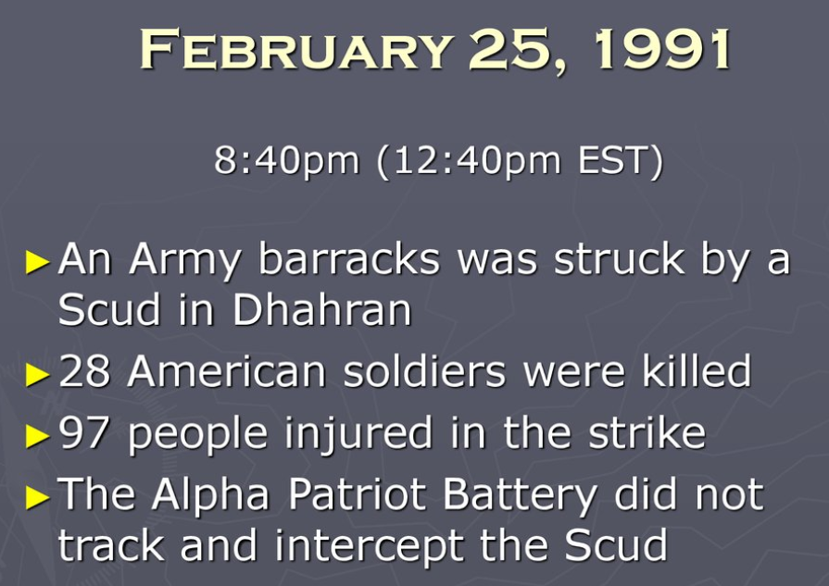
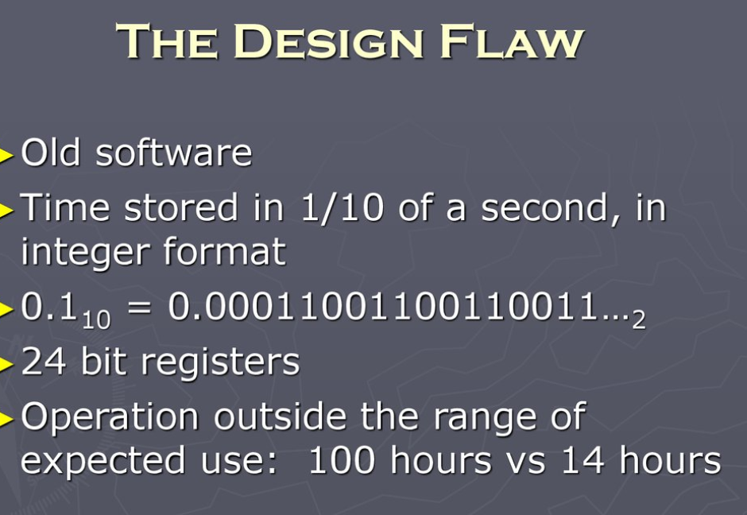

Slide 17
Free and Open-Source Operating Systems
Operating systems made available in source-code format rather than just binary closed-source and proprietary
Counter to the copy protection and Digital Rights Management (DRM) movement
Started by Free Software Foundation (FSF), which has “copyleft” GNU Public License (GPL)
  Free software and open-source software are two different ideas championed by different groups of people
    http://gnu.org/philosophy/open-source-misses-the-point.html/
Examples include GNU/Linux and BSD UNIX (including core of Mac OS X), and many more
Can use VMM like VMware Player (Free on Windows), Virtualbox (open source and free on many platforms - http://www.virtualbox.com)
  Use to run guest operating systems for exploration

Slide 18
The Study of Operating Systems
There has never been a more interesting time to study operating systems, and it has never been
easier. The open-source movement has overtaken operating systems, causing many of them to be
made available in both source and binary (executable) format. The list of operating
systems available in both formats includes Linux, BUSD UNIX, Solaris, and part of macOS.
The availability of source code allows us to study operating systems from the inside out.
Questions that we could once answer only by looking at documentation or the behavior of an
operating system we can now answer by examining the code itself.
Operating systems that are no longer commercially viable have been open-sourced as well, enabling
us to study how systems operated in a time of fewer CPU, memory, and storage resources.
An extensive but incomplete list of open-source operating-system projects is available
from https://curlie.org/Computers/Software/Operating_Systems/Open_Source/
In addition, the rise of virtualization as a mainstream (and frequently free) computer function
makes it possible to run many operating systems on top of one core system. For example, VMware
(http://www.vmware.com) providesa free “player” for Windows on which hundreds of free
“virtual appliances” can run. Virtualbox (http://www.virtualbox.com) provides a free, open-source
virtual machine manager on many operating systems. Using such tools, students can try out
hundreds of operating systems without dedicated hardware.
The advent of open-source operating systems has also made it easier to make the move from
student to operating-system developer. With some knowledge, some effort, and an Internet
connection, a student can even create a new operating-system distribution. Just a few years ago,
it was difficult or impossible to get access to source code. Now, such access is limited only by
how much interest, time, and disk space a student has.

Slide 19
End of Chapter 1

